Slide 1
Designing Dream Cars
STEAM Project Process & Resources
C. Bryant 2014

Slide 2
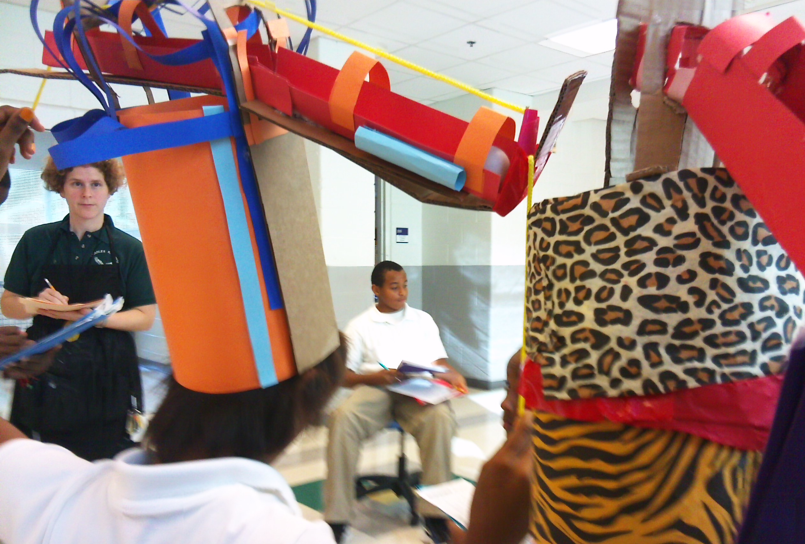
My Story…
Engineering Design Teacher @ Drew Charter School, Atlanta
Background in Pre-K-12 Art Education
Undergrad at Case Western Reserve University and Cleveland Institute of Art
Graduate School Maryland Institute College of Art

Slide 3
Process

Slide 4
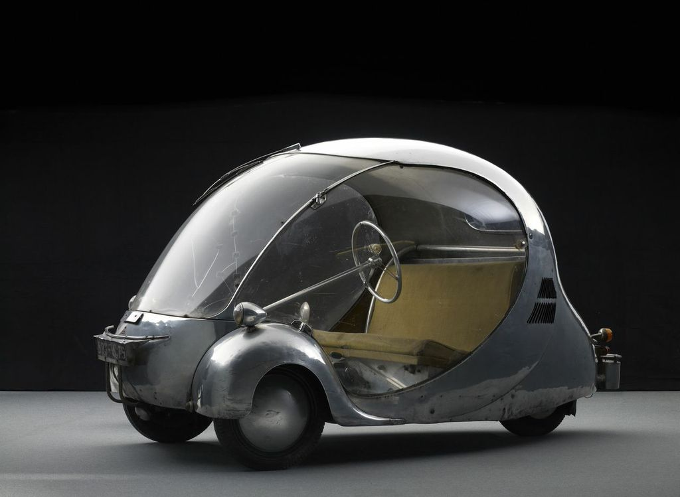
Real World Resource

Slide 5
Web Resources
Design Process:
http://www.jamesdysonfoundation.com/
Industrial Design/ Automotive Design:
http://www.cardesignnews.com/site/home/
http://www.idsa.org
http://www.cia.edu/academics/industrial-design
3-D sketching:
https://tinkercad.com/
http://www.sketchup.com/
http://www.123dapp.com/make
My website:
http://drewdesign.weebly.com/

Slide 6
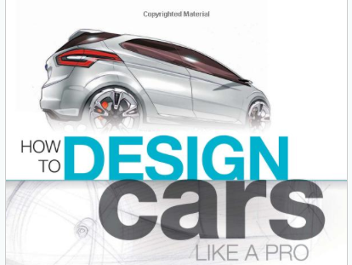
Text Resources
“If I Built a Car” by Chris Van Dusen
“Draw Cars” by Doug DuBosque
“How to Design Cars Like a Pro” by Tony Lewin and Ryan Borroff

