Slide 1
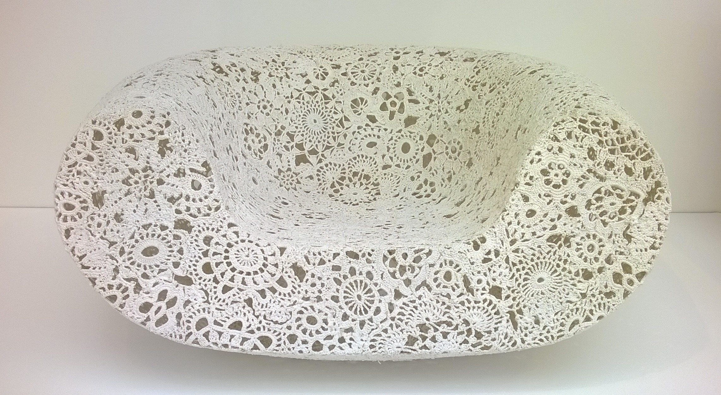
Sit or Not to Sit? Design The Answer!
C. Bryant 2015
STEAM Project Process & Resources

Slide 2
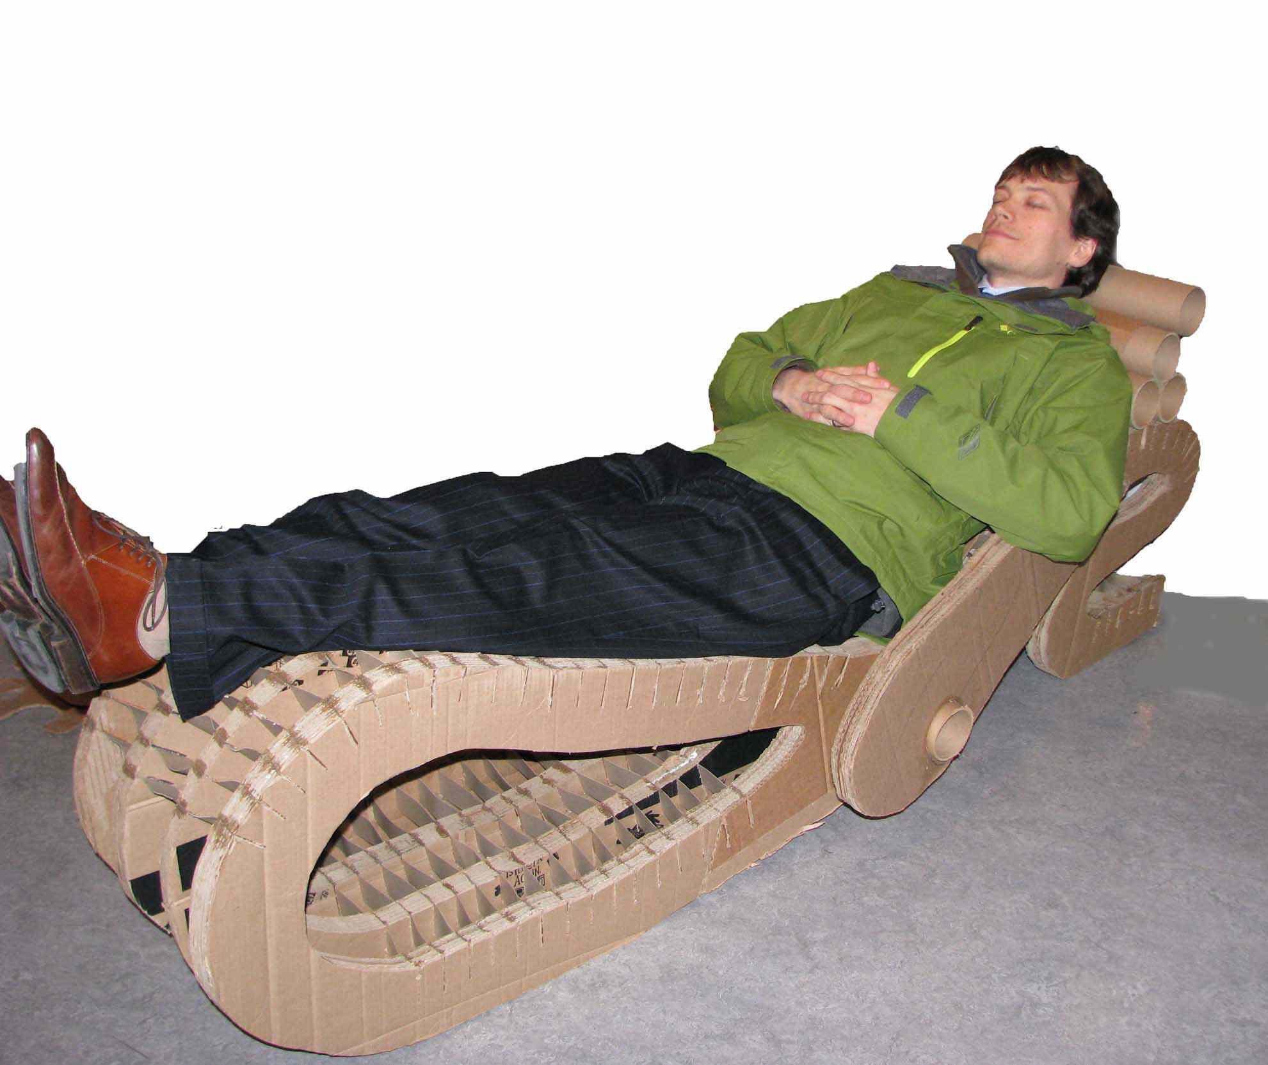
My Story…
Engineering Design Teacher @ Drew Charter School, Atlanta
Background in Pre-K-12 Art Education
Undergrad at Case Western Reserve University and Cleveland Institute of Art
Graduate School Maryland Institute College of Art

Slide 3
Process

Slide 4
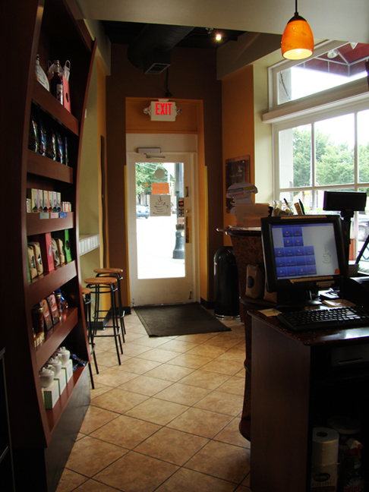
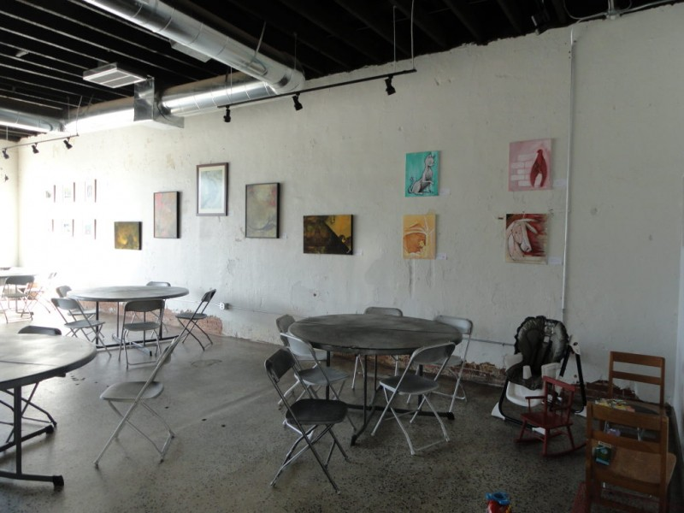
Sit or Not Brief:
Design a chair for one of the two coffee shop clients. Take into account their spatial requirements as well as customer needs.
ONE CAFFE COFFEE
HODGEPODGE COFFEE HOUSE
Hang-out space 3300 sq. feet
Ample seating—exceeds current need
Grab and go
Seating for 6
Outside space available

Slide 5
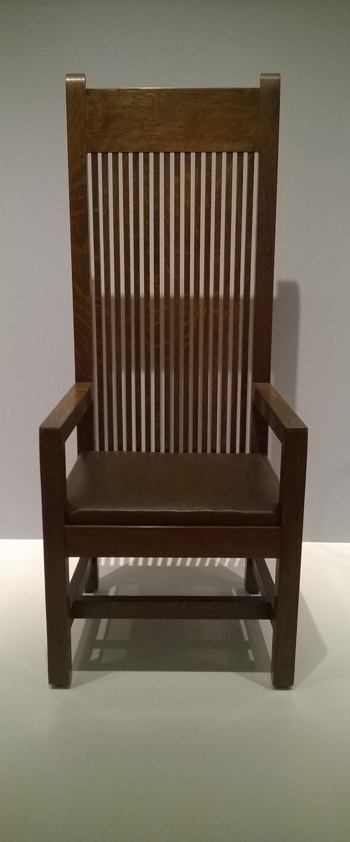
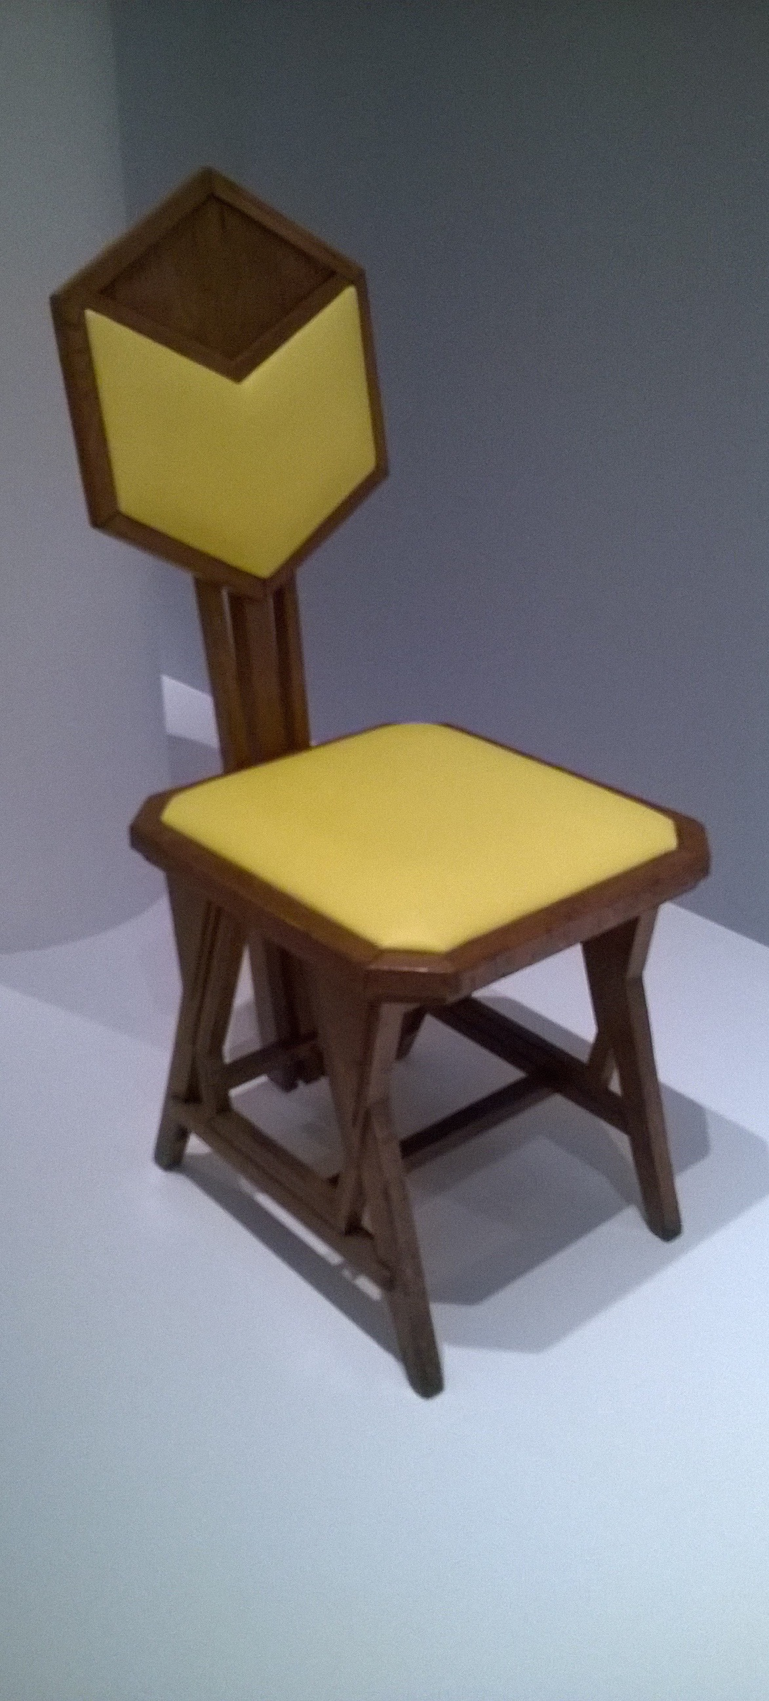
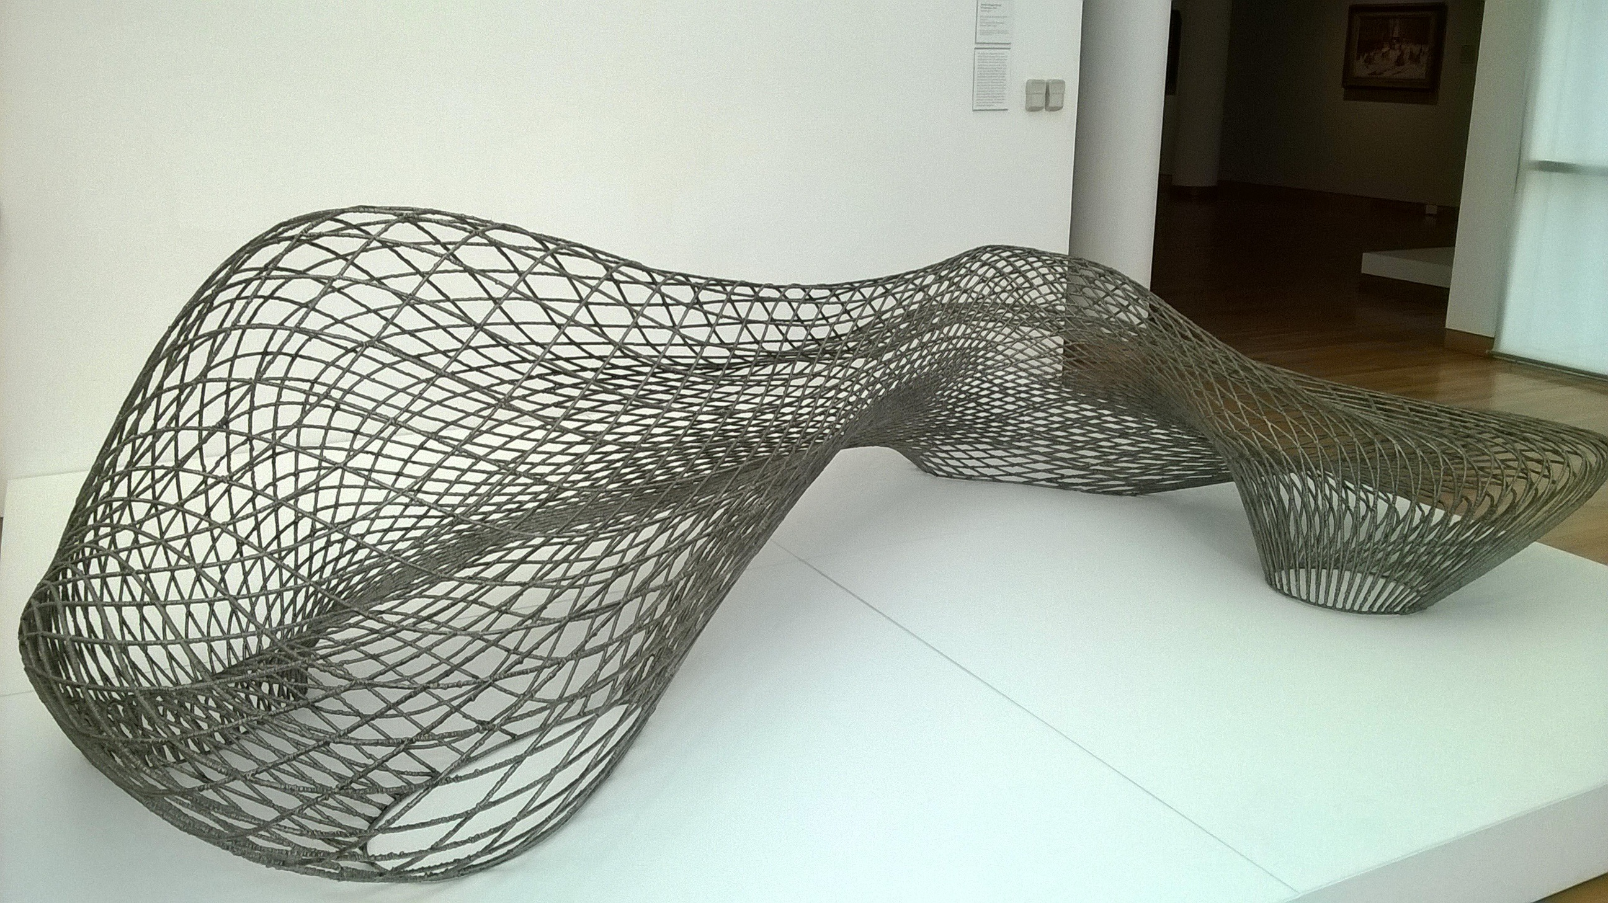
Real World Resource: HIGH MUSEUM
A
C
B
Humberto and Fernando Campana.
Frank Lloyd Wright
Frank Lloyd Wright
Joris Laarman
D

Slide 6
Web Resources
Design Process:
http://www.jamesdysonfoundation.com/
Industrial Design/ Furniture Design:
http://www.idsa.org
http://www.id.gatech.edu/
http://www.cia.edu/academics/industrial-design
http://www.scad.edu/academics/programs/industrial-design
3-D sketching:
https://tinkercad.com/
http://www.sketchup.com/
http://www.123dapp.com/make
My website:
http://drewdesign.weebly.com/

